Slide 1
A murine model of glucocorticoid myopathy alleviation using androgen therapy
Nicolae Lucian Sandor
July 13th, 2015
Notes:
Welcome. Today I will tell you about the insights I gained into glucocorticoid myopathy and its alleviation by androgen co-administration using an animal model. First, we need to define a few terms. What is glucocorticoid myopathy? In fact, what are glucocorticoids? NEXT

Slide 2
Glucocorticoids in humans
Stress hormones working towards hyperglycemia
Abnormally increased cortisol in Cushing’s syndrome.
Activate immunosuppressive mechanisms.
Prescribed to ~1% per annum.
Effects include
insulin resistance
osteopenia
muscle loss.
Less specific glucocorticoids cause edema.
Notes:
Glucocorticoids are a class of steroid hormones. You may have heard of cortisol as a “stress hormones”, meaning they are increased in various stress conditions, such as heart failure. Their main effect is increased blood sugar, that is, hyperglycemia. Hence the name. NEXT.
We learned a lot about what glucocorticoid effects from a condition called Cushing’s syndrome. Around the fifties, doctors understood that Cushing’s syndrome is caused by excess glucocorticoids secreted by an endocrine cancer. In addition to hyperglycemia, they found that excess glucocorticoids cause reduction in inflammation and immune supression. Once chemists learned how to purify glucocorticoids, physicians started using them for the treatment of immune exacerbations. First it was rheumatoid arthritis, but the glucocorticoids are now used from skin rashes to blood cancers. NEXT.
One percent of people in the developed world receive some kind of glucocorticoid therapy in any given year. Each of us runs a much higher risk of glucocorticoid excess from pharmacy. And many of the glucocorticoid users complain of side effects. In time, increased glycemia causes insulin resistance. Excess glucocorticoids also cause loss of bone – osteopenia – and loss of muscle. NEXT
One side effect we won’t talk about today is edema, meaning increased water retention in peripheral tissue. Less specific glucocorticoids can cause that too. But I will be focusing on the more specific glucocorticoids. The best example of specific glucocorticoid is dexamethasone, which is a synthetic glucocorticoid, modified by fluoridation to be more potent and more specific. NEXT

Slide 3
Glucocorticoid myopathy
Complaint of 50% of patients.
Objective loss of force, volume.
Electromyography demonstrates it is a myofiber condition.
Can be modelled in vitro.
Increased urinary nitrogen, methylhistidine.
Treatable by cessation, inhibitors, anabolic adjuvants.
Notes:
Glucocorticoid myopathy is the loss of muscle seen with excess glucocorticoids, be they from pharmacy or from oversecreting cancers. In surveys, more than half of patients with hypercortisolism of either cause complain of muscle weakness. Textbooks describe it as proximal, meaning that complaints are more often about the thighs than the toes. NEXT
The weakness patients complain about is an objective, measurable loss of force. With modern imaging techniques, such as MRI, we can tell that excess glucocorticoids also make muscles visibly smaller. NEXT
Electromyographic studies indicate that excess glucocorticoids impact on the myofibers, that is, the long, multinucleate, contractile cells of the muscle. This is important, because it shows this is not a condition of the neuron, of the vessel, or of the tendon. That is why it is called myopathy and not neuropathy. NEXT
Because it is a myofiber condition, it should be easy to model in a dish. Just pluck some myofibers from a living being, put them in a cell culture dish, add dexamethasone, and see what happens. NEXT
Human studies show that people with excess glucocorticoids have increased urinary nitrogen. Nitrogen is stored in the body in proteins, so excess glucocorticoids must be activating protein degradation. In fact, it’s not any protein that is degraded. Urine from these people has increased methyl histidine. Now, histidine is an amino acid, part of almost all proteins in the body, but it is methylated only in the muscle, when it is part of actin and myosin. The increase in urinary methylhistine shows that glucocorticoids stimulate protein degradation in muscle. NEXT
So what do you do to a patient with glucocorticoid myopathy? If it’s coming from a pill, you stop it. If it’s from a cancer, you excise it. But there are times when surgery is not an option. The source of cortisol is disseminated, spread in the body. And there are serious cases of blood cancer, when you cannot stop the glucocorticoid therapy. You may try a receptor inhibitor, but those are not very specific, and may defeat the purpose. Patients end up having to live with hypercortisolism. In these cases, the doctor will just have to fight the muscle loss with some anabolic therapy. Certainly, you may recommend a better diet, with more amino acids, but more commonly, when we say anabolic therapy, we think of anabolic steroids. NEXT

Slide 4
Testosterone to the rescue?
Effective in sarcopenia of aging, HIV+.
Causes increase in protein synthesis, intramuscular IGF-I.
Hypercortisolism reduces testosterone in men.
Anecdotal: was standard of care until 1980’s.
Crawford et al. (2003) showed Testo addition to chronic GC causes:
higher bone density
improved muscle mass and strength
better quality of life.
FDA warnings are not helping.
Notes:
The most common kind of anabolic steroid is testosterone. From clinical trials we know that it helps preserve muscle mass in aging men whose testosterone levels are naturally declining. It also helps in men with HIV whose muscle are atrophying. NEXT
The way testosterone works may differ from condition to condition and is still studied. Most commonly, clinical studies report that in men treated with testosterone, protein synthesis rate increases. Testosterone may also stimulate synthesis of another anabolic factor, insulin-like growth factor. NEXT
On the other hand, men with hypercortisolism have lower – still normal, but lower – testosterone. This suggests that these men may benefit if they receive testosterone supplementation, to restore their circulating testosterone levels to that of their peers. NEXT
Between the sixties and the eighties, the modern imaging was not available. In those days, it was more common for cancers to go unfound. You don’t need a big bump to get excess cortisol. So many patients had to live with increased glucocorticoids in their blood. In those days, testosterone was frequently given for loss of muscle due to hypercortisolism. No trials, nor large-scale observational studies were done, but, at an anecdotal level, it appears that testosterone was beneficial. NEXT
In modern times, there has been a clinical trial with good statistics and good outcome measurements. The trial enrolled men who received prednisone for lung disease, for an average of 8 years. In the beginning of the study, these men have weaker bones and muscle compared to other men of the same age. The men who were randomized to receive testosterone for a year got improved bone density, improved muscle force, and an improved quality of life. This is evidence that testosterone helps men with glucocorticoid myopathy. NEXT
Unfortunately, testosterone will not move into practice soon. Repeatedly, testosterone is associated with more or less reasonable worries. In the nineties, it was thought that testosterone therapy increases risk of prostate cancer. Nowadays, it’s thought it may increase the risk of heart attack. Even if there worries turn out to be unfounded, it will take a while until testosterone will be rehabilitated. So we need an alternative to testosterone, one that is both safer and perceived to be safe. In order to create testosterone alternatives, we need to better understand testosterone mechanisms. NEXT

Slide 5
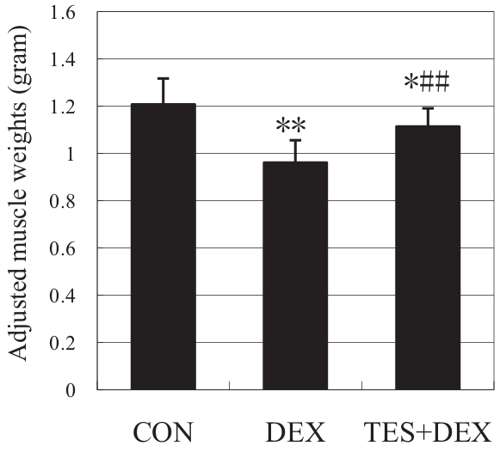
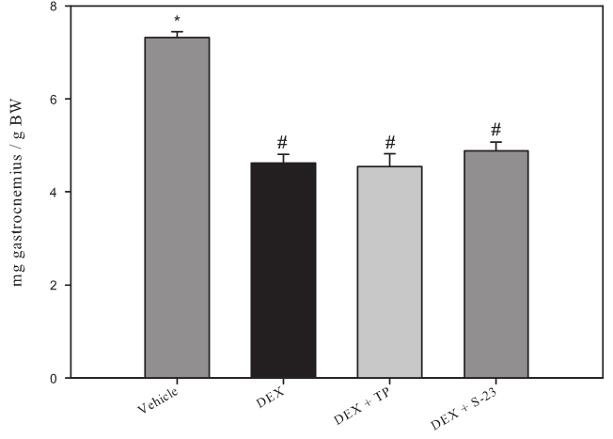
Rats may benefit from testosterone co-administration
Gastrocnemius.
Ten-day 1 mg/kg dexamethasone
± 5 mg/kg testosterone (Yin, J Trauma, 2009).
Gastrocnemius.
Eight-day 0.6 mg/kg dexamethasone
± 25 mg/kg testosterone (Jones, Endocrinology, 2010).
Notes:
There won’t be a randomized trial of two drugs perceived as dangerous, although they are very commonly prescribed. We have to rely on animal studies. Early studies using farm animals, such as sheep, cows, rabbits, failed to model glucocorticoid myopathy. In cows, the muscle fibers may shrink - we don’t know -, but cows have massive intramuscular fat deposits, which grow under dexamethasone stimulation. So cow muscle will grow thicker and heavier with glucocorticoids, even if less functional. NEXT
More recently, studies have looked at rats. Many studies confirm that, in rats, muscle mass is reduced by dexamethasone, by nearly 20% in a week or so. Here, we see that adding testosterone is beneficial to the rat, because it artly rescues muscle mass. So we may conclude that what we saw in Crawford study on humans is replicable on rats. Or is it? NEXT
In another study, we see the same loss of muscle mass with dexamethasone, but here, testosterone does not seem to help any longer, despite being given five times more. So it’s a coin toss? No, it is not, there is a third group, which published four papers on the subject, and they vote with muscle protection. So all in all, testosterone protects rat muscle from dexamethasone-induced atrophy. That sets us towards my first hypothesis. NEXT

Slide 6
Hypothesis
Testosterone alleviates dexamethasone-induced muscle atrophy in mice.
Notes:
Given that our best, off the shelf transgenics are mice, that the best microarray chips are for mice, I became more interested in mice. We know that mice exhibit loss of muscle in response to dexamethasone, but no one has looked into whether testosterone could prevent that loss of muscle. NEXT
My first hypothesis is that testosterone alleviates dexamethasone induced loss of muscle mass in mice. NEXT

Slide 7
Mechanisms of Dexa in rats
Increase in urinary 3MH.
Amino acid release decreases by 80% when co-treated with MG132.
Two E3 ligases (“atrogenes”) upregulated.
Other proteolytic mechanisms are involved.
Notes:
Let’s focus on the specifics of this atrophy model. As I said, rats and dexamethasone have been a more common combination in literature. NEXT
There, we see the same increase in urinary methylhistidine as in human studies, indicating that glucocorticoids stimulate protein degradation in muscle. I am not aware of a method of accurately collecting 24 hour urine from mice, without upsetting its cortisol levels, so it is not of much help for my studies. NEXT
Another rat experiment informs about the mechanism for this protein degradation. Say you take a rat and give it dexamethasone for a week. That puts it in a very catabolic state. If you take a muscle from this mouse, you will see it exuding free amino acids, due to that proteolytic activity. So let’s say you take a gastrocnemius from this rat, and you put in a test tube with warm buffer one such muscle. And then you take the other, contralateral muscle, and you put it in another test tube, with the same medium, but supplemented with MG132. This is a proteasome inhibitor. In the second tube, dexamethasone-stimulated amino acid release is cut down to a fifth. So most of the bulk protein digestion is done by a proteasome-dependent system. NEXT
Recent genomics studies showed that, similar to other atrophy models, loss of muscle caused by dexamethasone is correlated with an increase in expression of two E3 ligases, enzymes that catalyze the last step in the ubiquitin-mediated proteolysis. These are called atrogenes. So this is another line of evidence showing that muscle loss caused by glucocorticoids is reliant on the ubiquitin-proteasome system. NEXT
Before moving from proteolysis, we must recall that 20% of the increase in protein degradation seems independent of the proteasome. So other proteolytic systems may be involved.

Slide 8
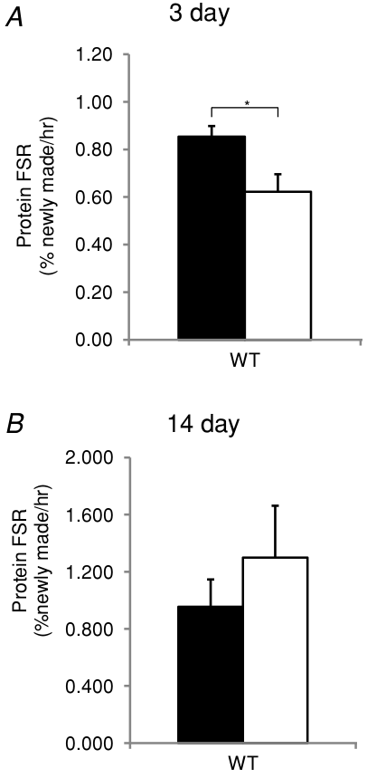
Protein synthesis and Dexa
3 mg/kg dexamethasone on male mice
(Baehr et al., J Physiol, 2012).
Notes:
There are a series of molecular clues that glucocorticoids, in addition to stimulating protein degradation, reduce protein synthesis. Unfortunately, studies looking directly at the rate of protein synthesis are rare and inconclusive.
In fact, this is the only study of protein synthesis rate in response to dexamethasone in mice. After three days, protein synthesis rate is reduced by dexamethasone. But after 14 days, protein synthesis is increased. Literature does not describe similar changes in protein degradation. This may mean that after sustained muscle loss, feedback mechanisms kick in, and protein synthesis responds. It also means that change in protein synthesis here, and in many other models of atrophy, is quite hard to prove. Choice of experimental conditions becomes very important. NEXT

Slide 9
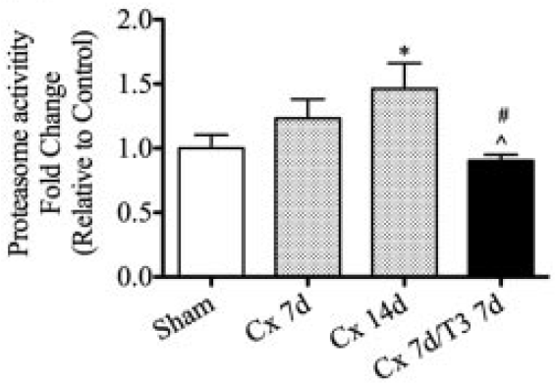
Testosterone effect on atrophying muscle
Often shown to improve protein synthesis.
Recently shown to inhibit protein degradation:
Ferrando et al., 2003, in burns.
Serra, Sandor, Bhasin, et al., 2013, in castrated mice.
Serra et al., Endocrinology, 2013.
Notes:
So how is testosterone working? As I said, it may depend from condition to condition, but in many other conditions, it improves protein synthesis rate. Recently, it has been shown that muscle may also lower the rate of protein degradation.
In Texas there is a group that measures proteasome catalytic activity in men receiving testosterone. They had shown testosterone’s protective effect in people with burns. Now, burns cause muscle loss and an increase in cortisol. It is not clear how much hypercortisolism affects muscle mass in the burned. But if hypercortisolism turns out to be the mechanism of muscle loss in burns, proteasome inhibition emerges as an important muscle protective mechanism. NEXT
Another study was run by Dr. Bhasin in my first year in his lab. I volunteered the idea that proteasome catalytic activity may be a good readout of the ubiquitin proteasome system. Indeed, castrating mice led to rapid loss of muscle, especially in levator ani, a perineal muscle, very sensitive to levels of testosterone. There, the loss of muscle was correlated with increased proteasome activity and with atrogene expression. Giving testosterone back to these castrated mice restored their muscle mass, and repressed their proteasome activity.

Slide 10
Hypotheses
Testosterone alleviates dexamethasone-induced muscle atrophy in mice.
Testosterone’s myoprotective action includes an anti-catabolic component.
Notes:
Given the new information that we had about the anti-catabolic action of testosterone, I formulated a second hypothesis, which is that testosterone’s protective action must include an anti-catabolic component.

Slide 11
Glucocorticoids’ transcriptional effect
Myostatin
Klf15
GR
MuRF1
muscle
loss
Dexa
Foxo
4EBP
Notes:
Glucocorticoids are steroid hormones, meaning they act through nuclear receptors which directly stimulate genes’ expression. Here are a few genes whose expression is upregulated by dexamethasone. NEXT
MuRF1 is one of those two E3 ligases associated with muscle atrophy. Its promoter has a glucocorticoid response element. But the other atrogene doesn’t have a glucocorticoid response element. Instead, MAFbx and MuRF1 have Foxo response elements. NEXT
Foxo transcription factors contain, in their promotor, glucocorticoid responsive elements. NEXT
Glucocorticoids also directly stimulate expression of Klf15, a transcription factor which induces expression of Foxo and of atrogenes. NEXT
As shown by Dr. Bhasin, glucocorticoids induce expression of myostatin, a negative regulator of muscle mass. NEXT
Finally, dexamethasone induces expression of a gene called 4E binding protein. The name explains the role. 4EBP binds and inactivates initiation factor 4E, which is required for initiating protein translation. Through expression of 4EBP, dexamethasone has a way to shut down protein synthesis. NEXT

Slide 12
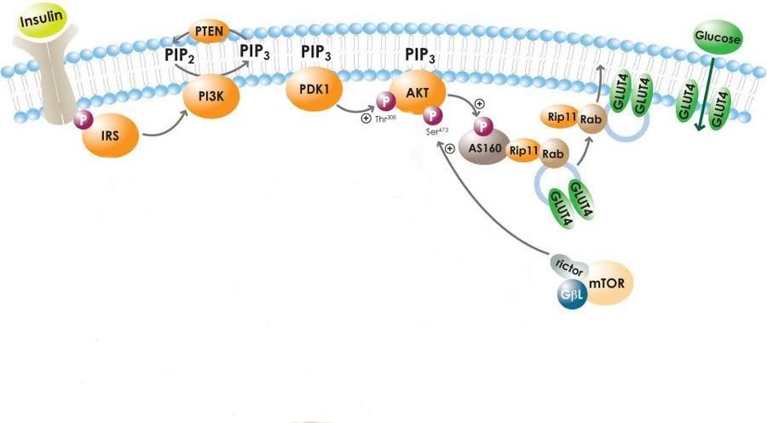
Insulin signaling desensitization
May, 2010
Glucocorticoids increase glucose and insulin, but lower glucose uptake.
Putative points of inhibition include IRS 1 and p85.
Notes:
In addition, there are less direct ways for dexamethasone to impose its muscle loss program. Remember that glucocorticoids cause hyperglycemia. They also cause increase in insulin. And yet, dexamethasone reduces glucose uptake into muscle. That is unusual, because insulin is supposed to stimulate glucose uptake into muscle. Somehow, dexamethasone and insulin fight it out, and dexamethasone wins. NEXT
This long pathway here shows what insulin does to normal muscle. Somewhere along this way, dexamethasone extinguishes insulin signals. NEXT
Two main candidates are best studied. First, glucocorticoids repress expression of insulin receptor substrate, IRS, thus leaving the insulin receptor without its closest relay. NEXT
Downstream, dexamethasone stimulates expression of p85 alpha, a subunit of PI3 kinase. This subunit is thought to prefer the cytosol, and therefore remove the whole of PI3 kinase from the membrane, where signaling is to be done. Others have shown that p85 is sequestered in the cytosol by the activated glucocorticoid receptor, a very interesting non-transcriptional effect.
So all in all, when we get to the kinase Akt, insulin signal is all but gone. How is that important? NEXT

Slide 13
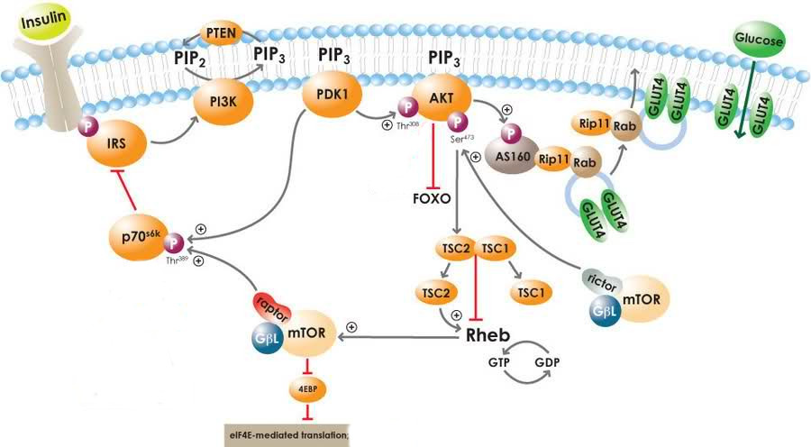
Results of Akt desensitization
Notes:
Well, Akt happens to neutralize some of our old acquaintances. Akt phosphorylates and inhibits the Foxo transcription factors. And indirectly, via mTOR, Akt phosphorylates and inhibits 4EBP. IF dexamethasone cuts down on Akt stimulus, that’s another way to facilitate the work of Foxo and 4EBP.

Slide 14
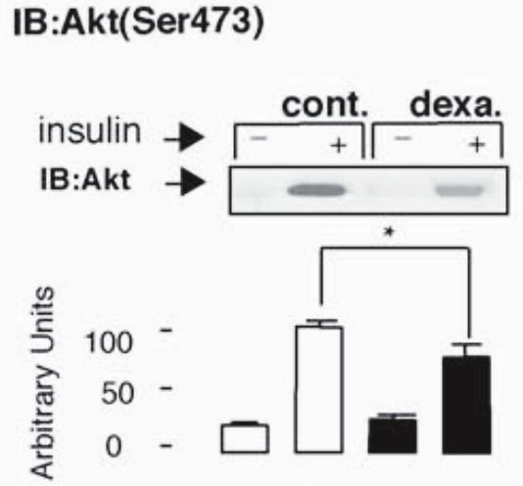
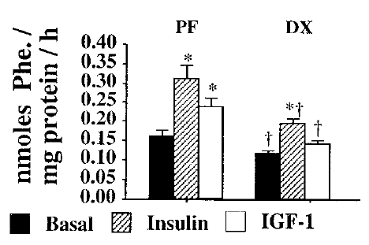
Insulin desensitization
Dardevet et al., J Endocr, 1998.
Rojas et al., Endocrin, 2003.
Also seen with IGF-I.
Dexa effect is easy to miss.
Notes:
This is how it works in practice. Say you excise a muscle from a rat, and soak into in radioactively labeled amino acids. The amount of tracer incorporated into new protein will give you an estimateof protein synthesis rate. If the animal was injected with insulin 90 seconds before excision, the rate of protein synthesis doubles. A similar anabolic effect is seen if the animal is injected with insulin-like growth factor, IGF-I. NEXT
If the rat was treated with dexamethasone for a week, insulin is not as anabolic anymore. Protein synthesis still increases in response to insulin, but not really double. NEXT
These data may be interpreted in a different way. We can instead look at dexamethasone effects. When no insulin was given, dexamethasone is repressing protein synthesis by 20%. NEXT
But when insulin is also present, dexamethasone’s effect appears ampler, more like 40%. So depending on conditions, the effects of dexamethasone on insulin signals may be seen more easily. NEXT
And this is an extreme example of the same problem. We are looking at phosphorylated, activated Akt. In basal conditions it appears flat, unchanged by dexamethasone. But it is well suppressed when animals were treated with insulin shortly before sacrifice. This has been an important issue for my study, and I thinl it’s worth pondering about it.

Slide 15
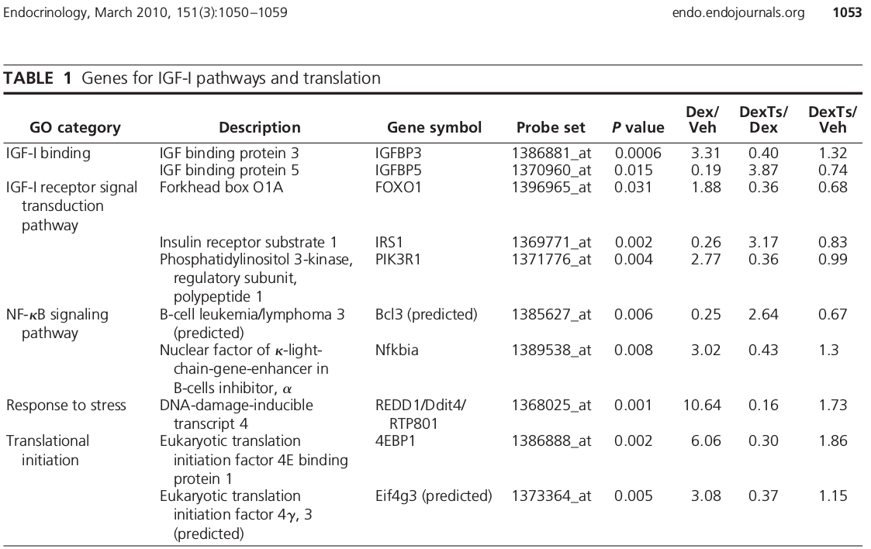
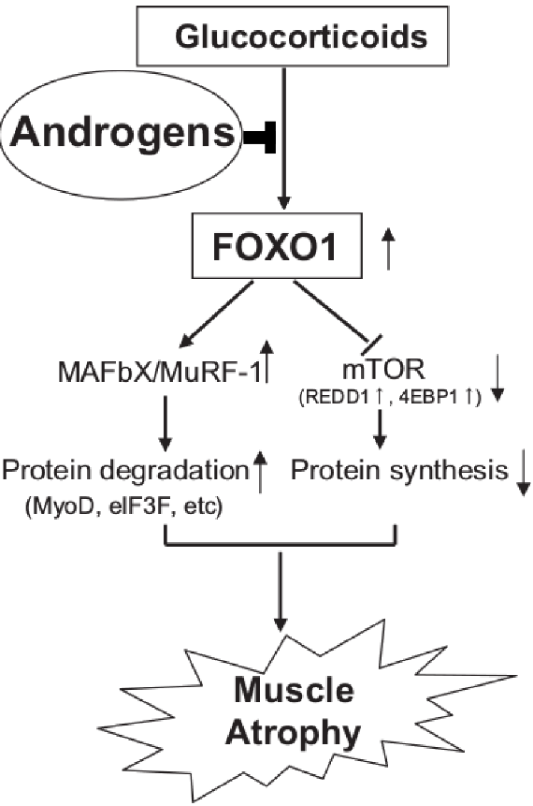
Foxo as mediators of testosterone muscle protection
Qin et al., BBRC, 2010.
Wu et al., Endocrinology, 2010.
Notes:
So what is testosterone doing in all this? Very little has been garnered from those three studies on rats. (And remember one of them actually declared testosterone ineffective.)
In a provocative way, the most recent of these studies, from Cardozo, ends with the results of a microarray. Usually the microarray is in the beginning of the paper, followed by some confirmations of the findings in observational and interventional studies. Well, here we just had the microarray results.
These are genes that were changed in one way by dexamethasone, and in the opposite way when testosterone was coadministered. Most of our old acquaintances are here: Foxo1, IRS1, p85 alpha, 4EBP. What is interesting is that not only Dexa had its usual effects on muscle, but testosterone seemed to repress each of these effects. So Cardozo came up with this model. NEXT
It appears that testosterone must act on the glucocorticoid atrophy signal early on, at its root. But it is unclear what is at that root. Cardozo left an empty space. It is not the glucocorticoid receptor itself, because, as you will see, testosterone’s effect is limited to the muscle, and does not occur in adipose tissue. So who could be upstream of Foxo? One candidate is Akt, which, I said earlier, can neutralize Foxo. But testosterone does not act directly on Akt. PAUSE
Who is further upstream of Akt? Akt is at the core of insulin and IGF-I signaling, and IGF-I is stimulated by testosterone. So here is my third hypothesis.

Slide 16
Hypotheses
Testosterone alleviates dexamethasone-induced muscle atrophy in mice.
Testosterone’s myoprotective action includes an anti-catabolic component.
Testosterone’s myoprotective action relies on inhibition of Foxo facilitated by restoration of IGF-I.
Notes:
Testosterone’s myoprotective action relies on inhibition of Foxo facilitated by restoration of IGF-I.

Slide 17

In vivo test
± 10 mg / kg D, ± 28 mg / kg T
Tissue collection
V
D
Time (days)
D+T
Eight week old, male, C57BL/6.
Notes:
I set to verify these hypotheses in a mouse model. I took young adult black mice and randomized them to vehicle, dexamethasone, or a combination of dexamethasone and testosterone. The doses of dexamethasone that worked on rats did not work on mice. The studies on mice either show no data about muscle mass, or even state vague things such as “mice received 3 milliliters of water with dexamethasone a day”. And there was no data on testosterone for mice to begin with. I settled on these doses based on the macroscopic effect. I injected the mice every day for 7 days.NEXT
I weighted them every day before the injection. NEXT
With an NMR spectrometer, I measured their body composition at the beginning and the end of the week. NMR
Twenty four hours after the last injection, I sacrificed them and collected a series of muscles. NEXT

Slide 18
Progressive loss of body weight is alleviated by testosterone
body weight
(% gain)
Stars indicate statistically significant differences between Veh and Dexa (p <0.05).
Daggers indicate statistically significant differences between Dexa and Comb (p <0.05).
Notes:
First, a word on the color convention. Black is for vehicle only, no steroid. Red is for dexamethasone-treated group. These are mice whose muscles sit at the red light, ok? And green is when the mice receive testosterone in addition to the dexamethasone.
One thing that I saw from body weight was that the condition was progressive. As the time goes by, dexamethasone treated mice become lighter and lighter compared to the vehicle-treated controls. On the other hand, combination-treated mice get better and better compared to the dexamethasone-alone group.

Slide 19
Deeper in vivo probe
V
Tissue collection
D
Time (days)
D+T
V
Tissue collection
D
Time (days)
D+T
V
Tissue collection
D
Time (days)
D+T
Notes:
So I got worried that I might miss something important that trigger the whole condition, and is extinguished early on. So I ran the same kind of experiment, with other mice, which were treated with the steroids for shorter times. I got one set on mice treated one day, another treated for three days, and another treated for seven days. There are different mice treated at different times, different time of the year. As is, these are different experiments. It is informative when they agree, but you should not imagine a time course linking them.

Slide 20
Net effects on body weight become evident when treated for longer
body weight
(% gain)
Notes:
Looking at body weight alone, there isn’t much to see. Remember that cows lose muscle and gain fat when treated with dexamethasone? It’s similar here. Only in seven-day treated mice, dexamethasone causes obvious loss of body weight in comparison to vehicle treated mice. This loss is rescued by testosterone coadministration.

Slide 21
Testosterone has little effect on fat and partly restores lean mass
fat mass
gain (g)
lean mass
loss (g)
Only dexamethasone alters fat deposits.
Notes:
If you look at fat mas alone, mice appear to grow even with vehicle, because that is what I inject them with – corn oil. However, mice that receive dexamethasone gain even more fat. Adding testosterone to dexamethasone does not bring them down to basal levels. NEXT
Dexamethasone causes a progressive loss in lean body mass. With shorter treatments it is not as obvious, but in the seven day treatment, you can see the protective effect of testosterone.

Slide 22
Testosterone partly restores individual muscles
gastrocnemius (g)
triceps br. (g)
quadriceps (g)
levator ani (g)
one day
three days
seven days
one day
three days
seven days
Notes:
When you look at individual muscles, you see a similar trend. It is more obvious at day 7 that dexamethasone causes loss of muscle mass, but testosterone addition restores at least half of the loss. If you look at regular muscles, the effect of dexamethasone becomes apparent even at day three, while testosterone seems to take its time. In fact, if you look at that perineal muscle, levator ani, which is very sensitive to testosterone, you see that testosterone is also active in the three-day treated mice.

Slide 23
Conclusion so far
Testosterone reduces dexamethasone-induced reduction in mouse muscle mass.
Notes:
So in conclusion, testosterone reduces dexamethasone-induced reduction in mouse muscle mass. The loss of muscle is progressive, but so is the benefit of testosterone co-administration.

Slide 24
MuRF1 is restored to baseline levels by testosterone co-administration
gastrocnemius MuRF1 mRNA
quadriceps MuRF1 mRNA
gastrocnemius MAFbx mRNA
quadriceps MAFbx mRNA
one day
three days
seven days
Notes:
I then set out to find how could muscle protection occur. I hypothesized an anti-catabolic action for testosterone, but there are three proteolytic pathways, each supported indirectly by Cardozo’s microarray data in rats. My first option was the proteasome ubiquitin system, so I looked at that.
MuRF1 was upregulated in multiple muscle groups, at almost every time I looked at, by dexamethasone. This confirmed what we knew from knockout studies, which indicate a crucial role for MuRF1 in dexamethasone-induced atrophy. What was interesting is that, especially in the 3- and 7- day group, testosterone co-administration suppressed MuRF1.
A similar pattern was seen with MAFbx. Dexamethasone induced it, and testosterone suppressed it. But dexamethasone’s effect was not as ample (see day 3 gastrocnemius). With less to repress, testosterones’s action on MAFbx was also less ample.

Slide 25
Chymotrypsin-like activity correlates with phenotype
quadriceps proteasome catalytic activity (rel.u.)
No ladder pattern of ubiquitinated myosin.
triceps proteasome catalytic activity (rel.u.)
three days
Notes:
When I measured proteasome catalytic activity, I found at day 3 a pattern that correlates with the phenotype, with dexamethasone stimulating proteasome activation, and testosterone repressing it toward basal levels. NEXT
I saw in a paper that, in atrophying muscle, myosin may appear as a ladder on immunoblot, indicating multiple ubiquitination states. I could not observe something like that, which probably explains why the finding was limited to one paper.

Slide 26
Dexamethasone represses autophagosome-associated genes
gastrocnemius beclin mRNA
gastrocnemius cathepsin L mRNA
gastrocnemius LC3 mRNA
one day
three days
seven days
Notes:
I then analyzed the autophagy pathway. In the world of dexamethasone studies there are two camps, those who see evidence of increased autophagy after dexamethasone treatment and those who don’t. OK, there is a third camps, those who switch camps. It’s not clear who is wrong, because there are no ideal ways of measuring autophagy.
I started by looking at some autophagy-related genes. When I looked at beclin, a gene essential for the formation of the autophagosome, I kept seeing that dexamethasone inhibited it at each time point. I looked at cathepsin L, the most important protease of the autophagosome-lysosome system, and dexamethasone did not amplify its expression either. I then looked at LC3, another autophagosome associated gene, and found the same lack of amplification.

Slide 27
Cathepsin L activity does not correlate with phenotype
gastrocnemius autophagosome catalytic activity (rel.u.)
quadriceps autophagosome catalytic activity (rel.u.)
triceps autophagosome catalytic activity (rel.u.)
one day
three days
seven days
Notes:
I also measured cathepsin L enzymatic activity. It was similar to the gene expression pattern in that dexamethasone did not appear to stimulate it. In fact, more often, dexamethasone reduced cathepsin L enzymatic activity in a statistically significant manner, and testosterone restored it towards basal levels.

Slide 28
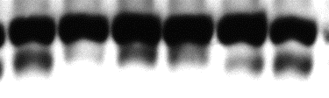

Lipidated LC3 isoform indicates autophagy unchanged
slow >
LC3
fast >
GAPDH
Dexa | - | - | + | + | + | +
Testo | - | - | - | - | + | +
LC3-II normalized to GAPDH
LC3-II normalized to LC3-I
Gastrocnemius, 7 day.
Sub-optimal normalization has been used by others to hypothesize role of autophagy.
Notes:
I also looked at LC3 in terms of protein levels. It has been quite hard to see the fast migrating, lipidated form, which is associated with autophagosomes, despite being able to see its slow migrating counterpart. And when I saw the fast-migrating LC3, I have noticed this ambiguous pattern. With dexamethasone, there is increase in lipidated LC3, if you normalize it to some unrelated, housekeeping protein, such as GAPDH. And testosterone co-administration suppresses it back. So now I became sympathetic to the camp who claim glucocorticoids stimulate autophagy.NEXT
But when I normalized lipidated LC3 to its precursor, the effect went away. PAUSE
I think this is an extreme example of why some claim autophagy is stimulated by Dexa, and others think it is not. But in the context of the other data, I would find it very hard to see upregulation of autophagy here.

Slide 29
Calpain markers did not correlate with the phenotype
gastrocnemius calpain catalytic activity (rel.u.)
one day
three days
seven days
Also, no change in mu-calpain, calpastatin protein levels.
Notes:
Calcium chelators also slows down proteolysis in muscle. So some groups got interested in these soluble calcium-dependent proteases called calpains. Turns out that meat scientists are very interested in calpains, because they make meat tender. Cardozo’s microarray said that testosterone represses an upregulation of calpain expression, so I thought it should be investigated. I did not see any change in protein levels of calpain ONE (also known as mu calpain), nor in its natural inhibitor calpastatin. When I measured calpain enzymatic activity, I didn’t see much protection from testosterone in this sector either.
So overall, among proteolytic systems, it appears that only proteasome-ubiquitin correlates with and may explain the phenotype.

Slide 30
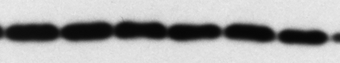


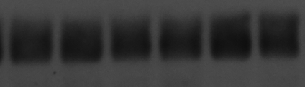
Translation regulators appear unchanged
Ⓟ-eIF2α
eIF3f
GAPDH
GAPDH
Dexa | — | — | + | + | + | +
Testo | — | — | — | — | + | +
Dexa | — | — | + | + | + | +
Testo | — | — | — | — | + | +
Ⓟ-eIF2α
eIF3-f
gastrocnemius, day 7
Notes:
I also wanted to look at the other side of the coin. As I said earlier, there are few studies measuring protein synthesis in response to dexamethasone, and they are not conclusive. I looked at a few regulators of protein synthesis.
A commonly studied break on protein synthesis is phosphorylation on initiation factor 2. Testosterone did not seem to have an effect on that. NEXT
I also looked at initiation factor 3f. This was reportedly suppressed in a series of atrophy models. The changes are nowhere near what I have seen in other papers. So there doesn’t seem to be musch protection conferred by testosterone either.

Slide 31
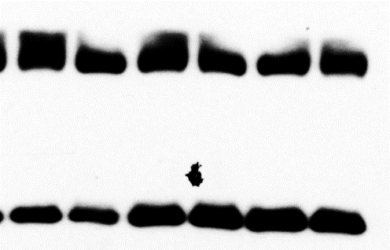
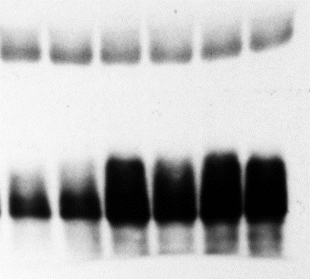
4E-BP is not inhibited by testosterone
GAPDH
GAPDH
Ⓟ-4EBP
total 4EBP
Dexa | — | — | + | + | + | +
Testo | — | — | — | — | + | +
Dexa | — | — | + | + | + | +
Testo | — | — | — | — | + | +
total 4EBP
Ⓟ-4EBP
gastrocnemius, day 7
Could not employ polysome profiling.
Notes:
I also looked at 4EBP protein levels. Cardozo’s microarray data predicted that dexamethasone will stimulate it. but the effect wasn’t that big. Also, the microarray suggested testosterone will reduce 4EBP protein level, but that is not seen here. NEXT
I also looked at phosphorylated 4EBP. This phosphorylation, you will recall, is inhibitory. Here, levels of phosphorylated 4EBP appear to increase with dexamethasone. This may be an artifact caused by increased 4EBP expression, driving up total and phosphorylated 4EBP. More important, testosterone does not seem to contribute towards an anabolic effect by increase phosphorylation of 4EBP either,

Slide 32
Conclusions so far
Calpains, protein synthesis markers do not correlate with testosterone-induced muscle rescue.
For both steroids, significant autophagy changes contrast with the phenotype.
Dexamethasone-induced loss of muscle is correlated with an increase in proteasome activity and E3 ligases expression.
Rescue by testosterone co-administration is best correlated with proteasome repression.
Notes:
In conclusion, calpains and protein synthesis markers do not correlate with testosterone-induced muscle rescue.
For both steroids, significant autophagy changes contrast with the phenotype.
Dexamethasone-induced loss of muscle is correlated with an increase in proteasome activity and E3 ligases expression.
Rescue by testosterone co-administration is best correlated with proteasome repression.

Slide 33
Testosterone pushes the transcriptional lever
quadriceps Foxo3a mRNA
quadriceps Klf15 mRNA
one day
three days
seven days
Notes:
So what molecular factors drive the rescue of muscle by testosterone? One way is to look a transcriptional mechanisms. This is only a sample, but I found that Foxo transcription factors 1, 3a and 4 are stimulated by dexamethasone in nearly any muscle and any time I looked at. Especially at days 3 and 7, testosterone co-administration caused suppression of these transcription factors.
I found a very similar profile for Klf 15. You may remember that Klf15 is a transcription factor that helps Foxo transcription drives up Foxo and atrogenes. I found that dexamethasone upregulates Klf15. In later stages, testosterone represses it down to basal levels.

Slide 34
IGF-I is partly restored by testosterone co-administration
quadriceps
IGF-I Ea mRNA
one day
three days
seven days
Notes:
I hypothesized that IGF-I is the lever that testosterone pushes back, in order to repress dexamethasone induced muscle loss. And indeed, across muscles and days, you see how dexamethasone suppresses IGF-I, and testosterone restores it.

Slide 35
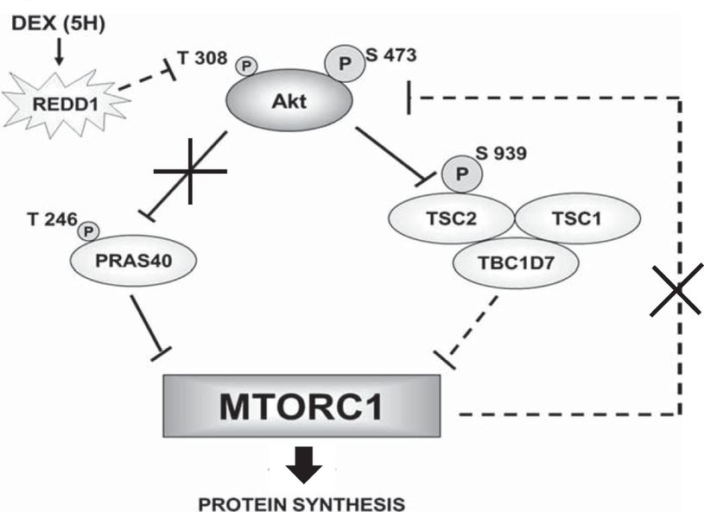
Even more Foxo activation
Britto et al., Am J Physiol, 2014.
Notes:
There was a detail from Cardozo’s picture that skipped over. Another gene that is upregulated by dexamethasone and restored to basal levels by testosterone is REDD1. The reason I went past that earlier is that Cardozo listed REDD1 as an mTOR inhibitor. Since November last year, we know that it acts further upstream, and in fact inhibits Akt. How does it do it? A dashed line is all we have for now.
Nevertheless, the REDD1 knockout does not get dexamethasone-induced muscle loss, so it is a very important mediator.

Slide 36
Testosterone partly reverses REDD1 upregulation
gastrocnemius
REDD1 mRNA
quadriceps
REDD1 mRNA
one day
three days
seven days
Notes:
I measured REDD1 in my mice and found out that dexamethasone stimulates it, while testosterone repressed down to basal levels. Back then, I though am looking at an mTOR inhibitor, but now I know I have yet another way for Dexamethasone to inhibit Akt. So dexamethasone is predicted to inhibit Akt through increased Redd1, decreased IGF-I, and perhaps in some other ways, such as through IRS, p85. Testosterone stop IGF-I and REDD1. Will that restore Akt signals? NEXT

Slide 37
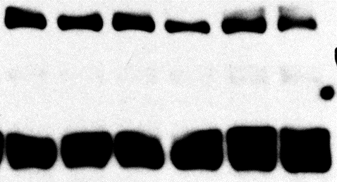
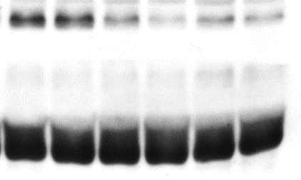
Akt (Ser 473) does not respond to testosterone
total Akt
Ⓟ473-Akt
GAPDH
GAPDH
Dexa | — | — | + | + | + | +
Testo | — | — | — | — | + | +
Dexa | — | — | + | + | + | +
Testo | — | — | — | — | + | +
total Akt
Ⓟ473-Akt
Ⓟ473-Akt /
total Akt
Gastrocnemius, 7 day.
Notes:
I am looking at just total Akt, and the steroids make no difference. And then I look at activated, phosphorylated Akt. And the answer is no, testosterone does not restore Akt in this assay. Dexamethasone reduced the activated form of Akt, but testosterone could not help it in a detectable manner.

Slide 38
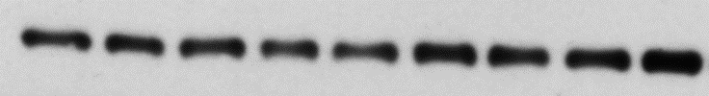

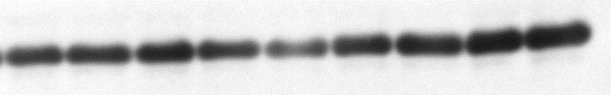
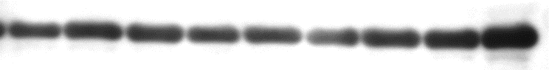
Akt (Ser 473) does not respond to testosterone in hypersensitive levator
total Akt
Ⓟ473-Akt
GAPDH
GAPDH
Dexa | — | — | — | + | + | + | + | + | +
Testo | — | — | — | — | — | — | + | + | +
Dexa | — | — | — | + | + | + | + | + | +
Testo | — | — | — | — | — | — | + | + | +
total Akt
Ⓟ473-Akt
Ⓟ473-Akt /
total Akt
Notes:
Not giving up, I checked Akt in levator ani. You remember this muscle benefitted the most from testosterone. And still, no change in total Akt, reduction in activated Akt with dexamethasone, and no rescue with testosterone.

Slide 39
Conclusions so far
Pro-atrophic transcriptional mediators Klf15 and Foxo are depressed by testosterone.
REDD1 and IGF-I are partly restored by testosterone.
Basal state repression of Akt by dexamethasone appears unchanged by testosterone co-administration.
Notes:
So in conclusion, pro-atrophic transcriptional mediators Klf15 and Foxo are depressed by testosterone.
REDD1 and IGF-I are partly restored by testosterone.
Basal state repression of Akt by dexamethasone appears unchanged by testosterone co-administration.

Slide 40
Hypotheses
Testosterone alleviates dexamethasone-induced muscle atrophy in mice.
Testosterone’s myoprotective action includes an anti-catabolic component.
Testosterone’s myoprotective action relies on inhibition of Foxo facilitated by restoration of IGF-I.
√
√
…
Notes:
So I am not done with the project. You see, I have shown that testosterone prevents dexamethasone-induced loss of muscle, that it does it by repressing the proteasome and Foxo. I even showed that IGF-I is restored by testosterone, but I couldn’t objectivize IGF-I downstream effects.
I have been wondering if I am looking at the wrong time. Remember that effects on Akt may appear larger or smaller depending on the choice of conditions. It seemed unlikely that this reliable restoration in IGF-I be inconsequential, so I decided to look at the same question in a cell model.

Slide 41
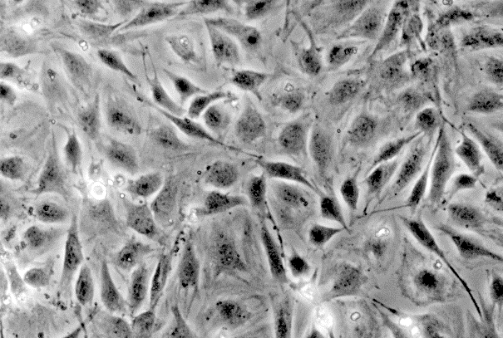
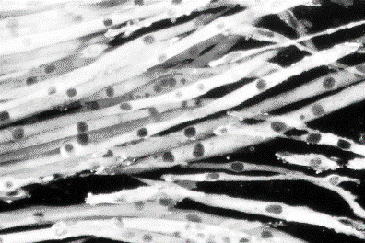
Dexa is anabolic, pro-proliferative for the undifferentiated muscle cells
Start differentiation
Serum-free medium
Time
(days)
Undifferentiated
Differentiated
Many studies discuss effect of the glucocorticoids or combination on proliferating or differentiating cells.
Many studies in rat cells.
Notes:
In vitro models of muscle cells share a few features. You start with mononucleate cells, change to serum-free medium at confluence, and in a few days you get long, multinucleate cells. But there are a few catches. NEXT
I found out the hard way that myoblasts collected from human donors die if they don’t get dexamethasone. Dexamethasone is in fact a great stimulus for the proliferation of those mononucleate precursors. Many studies were done at day 1 or 2 post-differentiation, when mononucleate proliferating cells are still around. These studies usually report that dexamethasone is an anabolic agent, which is quite the opposite of all we know about muscles. NEXT
Luckily, if I may say so, most studies were done in rat cells. So, I was again left to discover doses effective in mice cells.

Slide 42
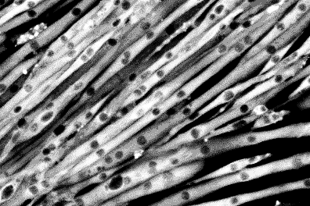
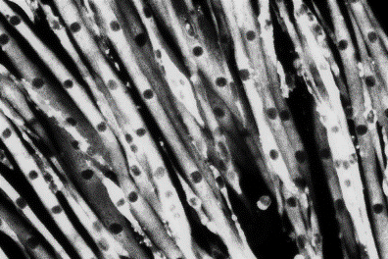
Cell diameter is rescued by testosterone co-administration
Start differentiation
Start pharmacological treatments
Diff. M.
±T±D
Time
(days)
Vehicle
Differentiated
50 µM Dexa
Dexa +
300 nM Testo
Notes:
An initial study was to just give them dexamethasone or the combination for two days, after seven days of differentiation. By that time, without serum, almost any proliferating cell was gone. You just look at the cells and see, well, not much.

Slide 43




Computer-assisted analysis
(B) Matlab
(A) Photoshop
average cell diameter (rel. u.)
Notes:
I ended up taking two microscopic fields and copying each cell, separately, on a huge canvas, using a semi-automated Photoshop tool called magic wand. Once you have that, Matlab can identify a cell contour, find its central axis (this brighter line in the center), and calculate diameters. Literally, these are operations described in a tutorial for Matlab beginners. NEXT
If you do that, you see that dexamethasone reduced myotube diameter by about 10%, and testosterone co-administration rescued the cells.

Slide 44
Total protein content is restored by testosterone co-administration
Start differentiation
Start pharmacological treatments
1 d
Diff. M.
±T±D
Time
(days)
2 d
Diff. M.
±T±D
total protein (normalized to first day)
At 48 hour, statistically significant difference between Dexa and Veh.
At 48 hour, statistically significant difference between Dexa and Dexa + Testo.
Notes:
I repeated the same, but with steroids given one day, two days, three days. In the first days, dexamethasone causes a reduction of total protein in the cell culture dish. If you add testosterone, the cell protein content is rescued in a dose dependent manner. So these are another line of evidence that in mice, testosterone prevents loss of muscle induced by dexamethasone.

Slide 45
Assaying protein synthesis in vitro
Start differentiation
Start pharmacological treatments
Diff. M.
6h (“0 d”)
±T±D
Time
(days)
³H-Phe
Diff. M.
1 d
±T±D
³H-Phe
Diff. M.
2 d
±T±D
³H-Phe
Diff. M.
3 d
±T±D
³H-Phe
Preliminary studies showed lack of sensitivity for 4h and 30h.
Notes:
I then did the same with a twist. Myotubes received steroids for 6 hours, 24 hours, 48, or 72. But in the last 6 hours of life, the cells were given a radioactively labeled amino acid. Preliminary studies showed little uptake for times shorter than 4h and little progression in uptake when tracer was given more than 30h. The amount of tracer bound to cell proteins in those six hours is an indicator of protein synthesis rate.

Slide 46
Protein synthesis exhibits paradoxical, late increase
tracer enrichment
in cell protein
(fmol/g)
At 72 hour, statistically significant difference between Dexa and Veh.
At 72 hour, statistically significant difference between Dexa and Dexa + Testo.
No change in pattern if normalization is foregone.
Notes:
My findings were unexpected. In the first days, there was not much difference between treatments. But later, at 48 and 72 hours, there is more tracer uptake in the cells treated with dexamethasone than in those that did not receive dexamethasone. So it appears that dexamethasone treated cells synthesize more protein. PAUSE
I am talking about cells that have been in dexamethasone for three days, and therefore shrunk. So it could be that these cells appear more enriched because, when you normalize by total protein, you divide by less. But if you don’t normalize, and only look at how much tracer is in a dish, you still see more tracer taken intro protein in the dexamethasone-treated cells. So that suggests that indeed dexamethasone-treated cells get better at synthesizing protein after a few days of protein loss. My interpretation is that lateness and direction against the phenotype are showing protein synthesis as a reactive phenomenon, caused by feedback.
Interestingly, testosterone coadministration makes these cells behave as if they received neither drug. This also suits the feedback hypothesis. No total protein was lost with the combination, so no feedback mechanism is triggered.

Slide 47
Assaying protein degradation in vitro
Start differentiation
Start pharmacological treatments
Diff. M.
Time
(days)
0 d
±T±D
³H-Phe
Diff. M.
1 d
±T±D
³H-Phe
Diff. M.
2 d
±T±D
³H-Phe
Diff. M.
3 d
±T±D
³H-Phe
Notes:
I also measured the rate of protein degradation. This is another twist on the first experiment. Cells are differentiated for 7 days, given steroids afterwards for 1, 2, 3 days. But in a change, cells are grown for a very long time at fixed concentration of radioactive aminoacid. Only in the last 6 hours of life, I am removing completely the radioactive amino acid from the medium. The amount of non-protein radioactivity formed in those 6 hours indicates how fast protein degradation occurs.

Slide 48
Protein degradation correlates with phenotype
medium to cell protein tracer ratio
At 24 hour, statistically significant difference between Dexa and Veh.
At 24 hour, statistically significant difference between Dexa and Dexa + 500 nM Testo.

Slide 49
Inhibitor tests in vitro
Protein
labeling
Start steroid
treatments
Start
differentiation
Diff. M.
Time (days)
±T±D
³H-Phe
Collection of measured medium

Slide 50
Proteasome is responsible for bulk digestion
medium to cell protein tracer ratio
Dexa stimulates tracer release.
Strongest inhibition of proteolysis with proteasome inhibitor MG132.
Non-negligible effect of lysosome inhibitor chloroquine.
Repression to basal level with T co-administration.
IGF1R inhibitor did not alter T effect.

Slide 51
Cell model conclusions
Muscle cells are protected by testosterone co-administration.
Protein degradation, more than protein synthesis, is correlated with total protein, and could explain testosterone effects.

Slide 52
Limitations
I could not observe IGF-I downstream effects, perhaps due to overriding circumstances.
Roles of Foxo, Akt, REDD1, IGF-I were studied in observational manner.
There is no direct method of measurement for autophagy.
Protein synthesis assays are fraught by the denominator effect.

Slide 53
General model
Glucocorticoids
Anabolic steroids
REDD1
IGF-I
Akt
Foxo
MuRF1
proteasome / ubiquitin - mediated catabolism

Slide 54

Acknowledgements
Notes:
I am deeply indebted to the members of my committee, Profs. Caroline Apovian, Shalender Bhasin, Isabel Dominguez, Konstantin Kandror, Monty Montano, and Carlo Serra.
I am grateful to the leaders of the graduate programs at Boston University School of Medicine, Profs. William Cruikshank, David Atkinson, and Mary Jo Murnane.
I am commending the assistance I received from Drs. Wen Guo, Mikhail Zakharov, Gianluca Toraldo, and Michael Panichas.
I am also obliged to Mary Kathleen Deloge.
I am also thanking my past mentors, Profs. Vasile Munteanu, Alex Babes, Gordon Reid, Anne Treisman, and Assen Marintchev.
I am thanking my wife who must have seen this ten times before.
I am thanking the government and the nation for the money, and BU for making it happen.

